Slide 1

Show And Tell: Image Caption Generator Based On CNN And RNN
Team 6-3
Yue Zeng
Class ID: 30

Slide 2
Abstract
Goal: generate caption for animal image
Approach: show and tell model
Evaluation:
BLEU((bilingual evaluation understudy)
CIDER(Consensus-based Image Description Evaluation)
METEOR(Metric for Evaluation of Translation with Explicit ORdering)
ROGUE(Recall-Oriented Understudy for Gisting Evaluation)

Slide 3
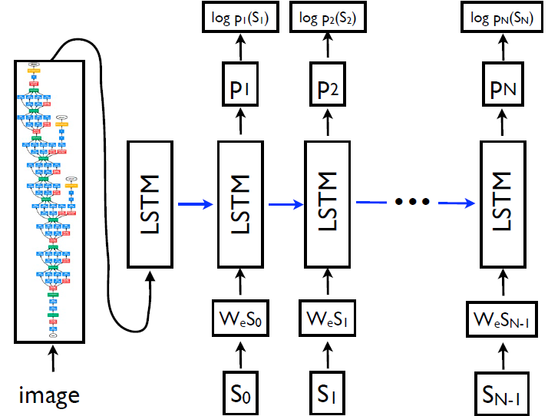
Introduction
CNN
RNN+LSTM
Show and tell

Slide 4
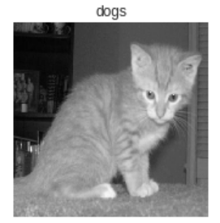
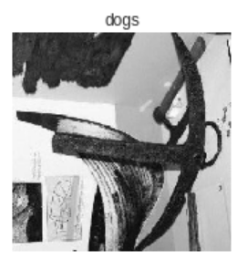
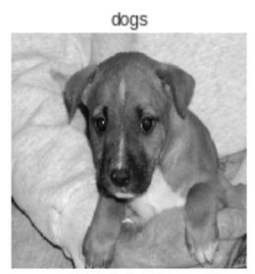
Implement
CNN

Slide 5
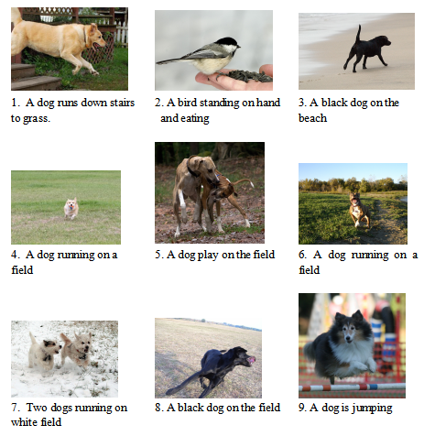
Show and tell

Slide 6
Evaluate
Metrics | BLEU-4 | METEOR | CIDER | ROGUE
Show and tell | 26.5 | 22.3 | 84.6 | 0.503
Human | 22.8 | 25.4 | 86.1 | 0.496

Slide 7
Thanks!

